Slide 1

Meme-Machine
Brought to you by: char broiled;
Group Members:
Matthew Jagielski, Jacob Bieker, Ian Garrett, Theodore LaGrow

Slide 2
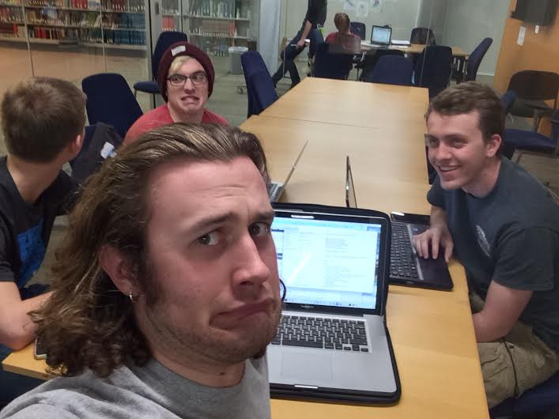
Overview of Project
Code so hard
Server/Client Chat
Encryption
Meme-afy
Qt Gui
Memes wanna
find me

Slide 3
Overview of Project
Code so hard
Server/Client Chat
Encryption
Meme-afy
Qt Gui
Memes wanna
find me

Slide 4
Code so hard
Memes wanna
find me

Slide 5
Overview of Project
Code so hard
Server/Client Chat
Encryption
Meme-afy
Qt Gui
Memes wanna
find me

Slide 6
Overview of Project
Code so hard
Server/Client Chat
Encryption
Meme-afy
Qt Gui
Memes wanna
find me

Slide 7
Overview of Project
Code so hard
Server/Client Chat
Encryption
Meme-afy
Qt Gui
Memes wanna
find me

Slide 8
Overview of Project
Code so hard
Server/Client Chat
Encryption
Meme-afy
Qt Gui
Memes wanna
find me

Slide 9
Overview of Project
Code so hard
Server/Client Chat
Encryption
Meme-afy
Qt Gui
Memes wanna
find me

Slide 10
Overview of Project
Code so hard
Server/Client Chat
Encryption
Meme-afy
Qt Gui
Memes wanna
find me

Slide 11
Demonstration
(Hopefully the code works!)

Slide 12
Risk Management
Made sure we could run all of the code on our own computers
Did get everything hooked up

Slide 13
Questions?

Slide 14
Thank you!

